Slide 1

Exploration Through Augmented and Virtual Reality
Team Members:
Rohini Yedelli
Vaibhav Goyal
Radhika Raghuwanshi
Mentor: Mrs. Smita Jangale

Slide 2

Introduction To Augmented and Virtual Reality :
Virtual Reality is a computer simulated reality which replicates a real environment, and simulate a user's physical presence in this environment while Augmented Reality blurs the line between what's real and what's computer-generated by enhancing what we see, hear and feel.

Slide 3
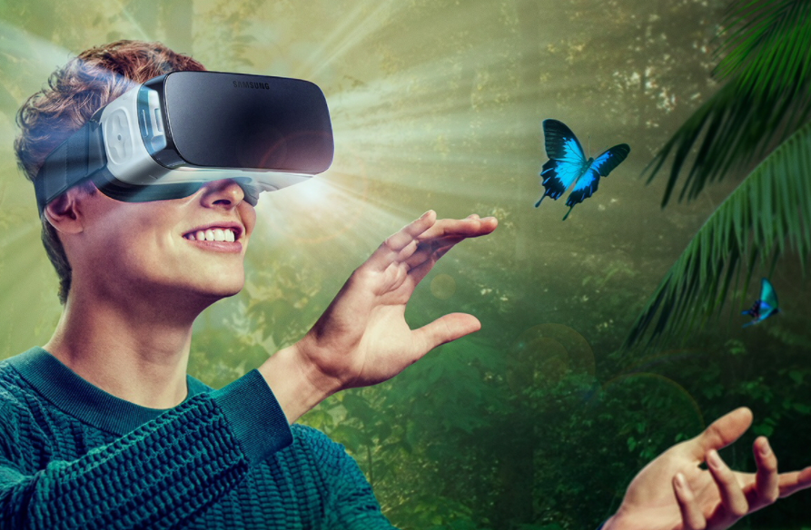
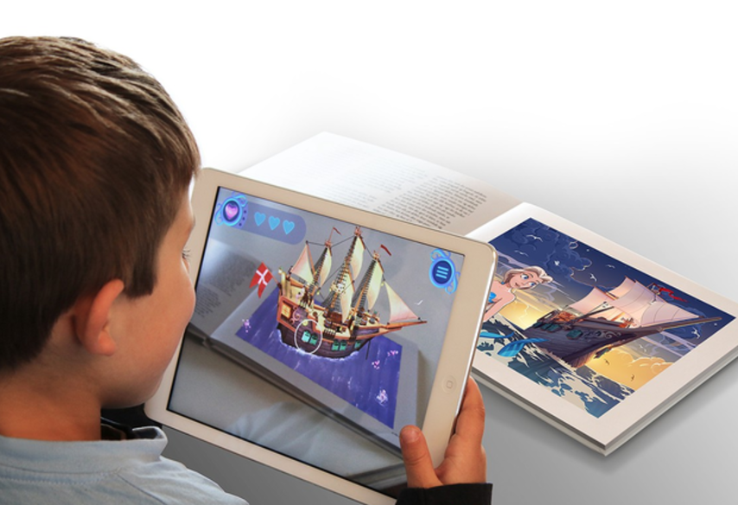

Slide 4

History
In 1968, Ivan Sutherland developed the first head-mounted display system.
In 1974, Myron Krueger built an ‘artificial reality laboratory called the video place which combined projectors with video cameras that emitted onscreen silhouettes, surrounding user in an interactive environment.
In 1990, Boeing Researcher Tom Caudell coined the term “Augmented Reality”.
In 1994, Julie Martin the first augmented reality Theater production, “Dancing in Cyberspace”, featuring acrobats who danced within and around virtual objects on their physical stage.
In 1999, Naval researchers begin working on Battlefield Augmented Reality System[BARS], the robust, original model of early wearable units for soldiers.
In 2009, print media “Esquire Magazine” tried out AR, in which it prompted readers to scan the cover to make Robert Downey Jr. come alive

Slide 5

Literature Survey
Components of Augmented Reality-
Augmented reality systems are built upon on three major buildings blocks:
Tracking and Registration
Display technology
Real time rendering

Slide 6
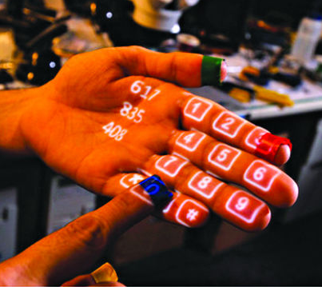
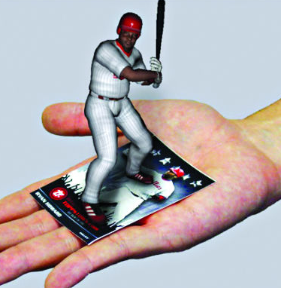
Types of Augmented Reality
Projection Based AR
Recognition Based AR

Slide 7
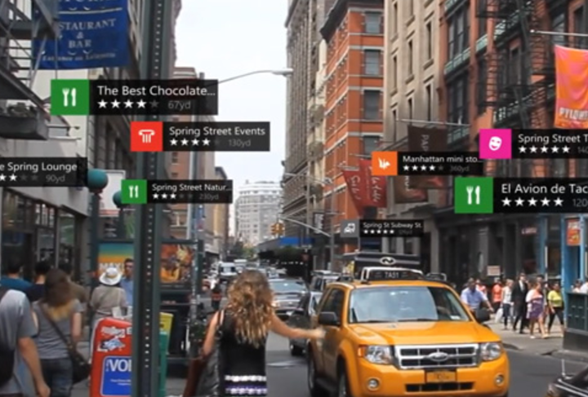
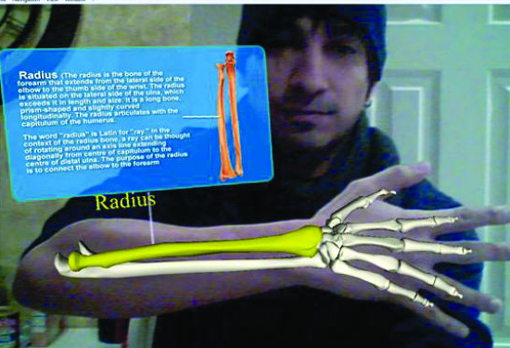
Location Based AR
Superimposition Based AR

Slide 8

Objective
The objective of the proposed project is to provide a more immersive and interactive environment to the user to learn about different things. The projected virtual objects display details that are difficult to imagine by the user. The information conveyed by the virtual objects helps a user perform real-world tasks. “Exploration” will help to inculcate learning and provide amazing experience to kids as well as adults. It will provide them a whole new look towards virtual world using Virtual and Augmented Reality.

Slide 9

Hardware/Software Requirements
Unity3D (Personal edition)
Vuforia
C#
VR Headset
Smartphone with Gyroscope and Magnetometer
sensor

Slide 10

Project Outcomes
Outcome of the project will be an android application “Exploration”using Recognition based AR. Exploration app will be a marker based augmented reality using Android OS. In this project, we aim to investigate and apply various innovative applications of Virtual and Augmented Reality on real life surroundings and enhance the skills of individuals and society in an interactive manner.

Slide 11
END

